Slide 1
Unlocking the Value of Brownfields in Your Community
OEMC 2015

Slide 2
John Desbiens, P.Eng.
Cambium Inc. President/CEO
Peterborough Economic Development Director
Greater Peterborough Innovation Cluster Chair
Ontario Onsite Wastewater Association Director
CAWT Technology Access Centre Advisory Board
Trent (University) Business Council Co-Chair
Peterborough Ultimate League Vice President

Slide 3
Intent of this talk
Inspire More Proactive Effort for Brownfields Rehabilitation & Redevelopment in our Communities

Slide 4
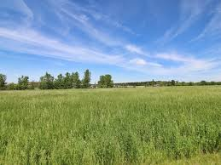
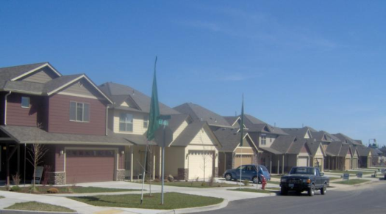
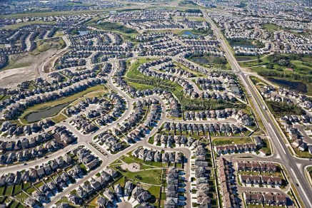
The Greenfields Trap
Developers minimize additional time and cost to maximize project profits
Municipalities are supportive for growing tax base and new “free” infrastructure
These outcomes are most commonly achieved in Greenfield developments
Notes:
URBAN SPRAWL

Slide 5
20th Century & Urban Sprawl
Sprawl is inefficient use of existing built and natural environments
Showing to be unsustainable
Asset Management Plans are proving the need for change in development/growth strategies
Fueled by automobile biased planning and development
Notes:
Rates of travel for majority of population allowed for new paradigm of community design

Slide 6
before automobiles…
Travel was slower
Assisted travel less common
Concentrated populations
Dense urban infrastructure
Incremental intensification
Notes:
Had become easier to drive past a brownfield than to give attention to it
Trending back to Incremental Urban Intensification

Slide 7
Incremental Intensification
Maximized use of infrastructure
More proximate mixed land use
Promotion of active transportation
Preservation of agricultural lands
Preservation of natural assets
Reduction of GHG
Notes:
Had become easier to drive past a brownfield
Before the automobile ; Back to Incremental Urban Intensification
Closely shorn grass lawns first emerged in 17th century England at the homes of large, wealthy landowners. While sheep were still grazed on many such park-lands, land owners increasingly depended on human labor to tend the grass closest to their homes. Before lawnmowers, only the rich could afford to hire the many hands needed to scythe and weed the grass, so a lawn was a mark of wealth and status.

Slide 8
Infill Development
More municipalities are receiving development proposals within existing built urban boundaries
Prompted by realty conditions; generally positive for communities
CIPs and associated crafted incentives are passively effective for the repurposing of properties
Notes:
Low hanging fruit taken first

Slide 9
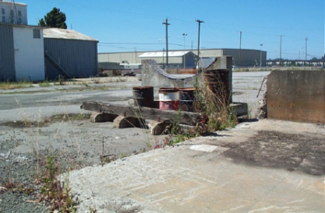
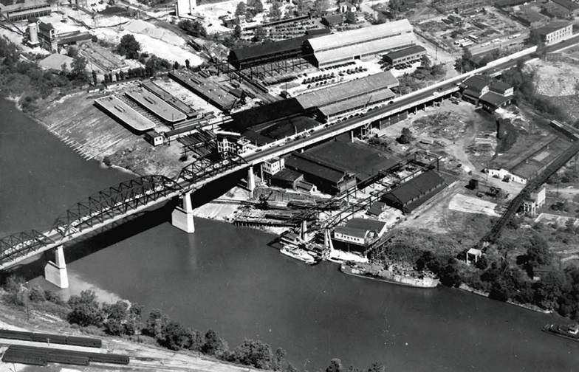
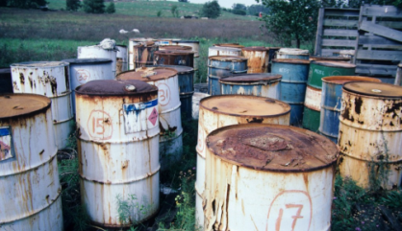
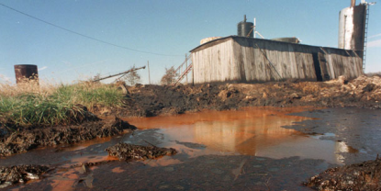
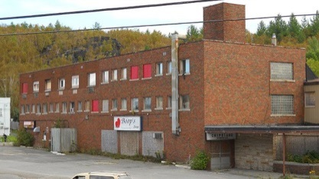
What is a Brownfield?
Derelict, vacant, or under-utilized places where past industrial or commercial activities may have left structures/materials behind
Notes:
include old and abandoned refineries, former railway yards, old waterfronts, crumbling warehouses, abandoned gas stations, former drycleaners and other commercial properties where toxic substances may have been used or stored.

Slide 10
Brownfields Often…
are contaminated
contain hazardous substances
degrade nearby properties
pose health and safety risks
reduce local property values
impact socio-culturally

Slide 11
Brownfield development ASAP
Impact Mitigation
environmental degradation
public health and safety risks
Potential Value
Revitalize neighbourhoods
“Place-making” and stronger communities
Increase economic and business activity
Promote intensification; curb urban sprawl

Slide 12
Brownfields Repurposed
Interim or long term:
parking, community gardens, parks;
cultural and social enterprises;
energy generation;
commercial spaces;
institutions;
industry;
housing; etc.
Notes:
Depending on the setting of course

Slide 13
What is the Hold-up?
Often it’s brownfield unknowns:
Geotechnical setting
Site servicing capacity
Archeological/Heritage
OP and zoning flexibility
Structural integrity
Hazardous building substances
Contamination
Notes:
$$$$$$$$$$$$$$

Slide 14
Community Improvement Plan
CIPs will encourage some desired development by experienced opportunists
Developers still are still motivated by time and cost; unknowns create uncertainties for unacceptable risk
Notes:
Isn’t promotion enough

Slide 15
Therefore …
Development activity may not happen where and when it is needed most
May not be what is needed most
Notes:
Hope is not a course of action

Slide 16
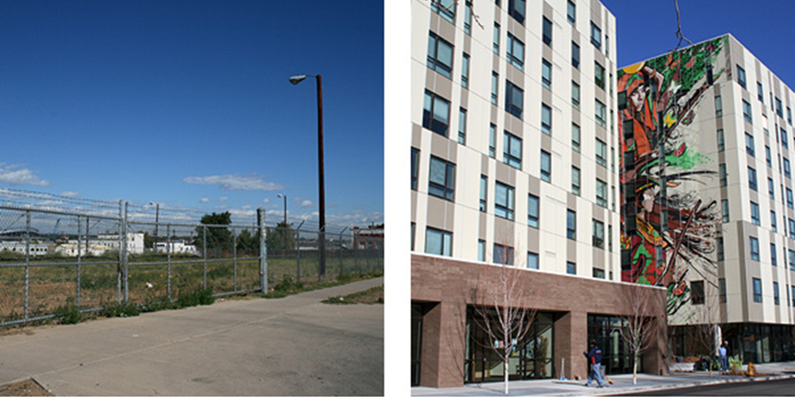
Proactive on Brownfields
Municipal leadership to stimulate desired development on the most problematic areas (brownfields).
Notes:
Municipal Leadership in the form of Community Development Team

Slide 17
Community Development Team
Community Planning
Economic Development
Support and Facilitation
Promotion & Attraction
Asset Inventories
Approvals & Guidance
Place making
Growth, Master, and Comm. Imp. Plans
Needs Assessments
Economic Ecology Cultivation
Proactive Brownfields Development Program

Slide 18
Proactive Brownfields Program
PLAN – STUDY – REMED – REDEV
A program providing technical and financial support when past land use of properties is a concern
Some support provided by municipal resources -- remainder will require third party expertise
Notes:
a resource for property owners, developers, community organizations, and neighbors who are interested in cleaning up brownfields, recovering neighborhood land.

Slide 19
Brownfields Inventory
Where are they
Available information (and gaps)
Properties characteristics
Reason for their current states
Property owners (public & private)
Future plans of owners

Slide 20
Privately owned Brownfields
Owners to be engaged by community development team
Ensure awareness of incentives and programs available
Offer support to motivated owners wishing to sell or develop
Municipal approval process should be responsive for brownfield projects

Slide 21
Municipal Brownfields
Errrr, let’s not dwell on the past…
Opportunity to access value sooner
If desired development outcome is not within municipal operations then “set the table”
Uncertainties should be addressed to reduce risk and entice investment

Slide 22
Revisiting the Uncertainties
Site servicing capacity
OP and zoning flexibility
Archeological/Heritage
Geotechnical setting
Structural integrity
Hazardous building substances
Contamination liability
Notes:
$$$$$$$$$$$$$$
Argentina - Second Mining Development Technical Assistance Project (PASMA II)

Slide 23
Brownfields Studies for Rehab
Hazardous Materials
Asbestos Survey and Abatement
Designated Substance Survey
Environmental Site Assessments
Phase I
Phase II
Remediation / Risk Assessment
Record of Site Condition
Notes:
What are the implementation costs in bullet #1?

Slide 24
Designated Substance Surveys (DSS)
Substance to which the exposure of a worker is prohibited, regulated, restricted, limited or controlled.
Eleven designated substances in Ontario:
Asbestos
Lead
Mercury
Silica
Benzene
Arsenic
Coke Oven Emissions
Acrylonitrile
Isocyanates
Vinyl Chloride
Ethylene Oxide
Notes:
Should we mention PCB’s? They are being phased out at the end of this year (but fluorescent light ballasts are exempt)

Slide 25
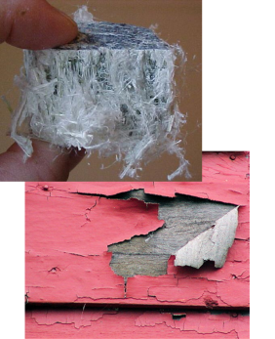
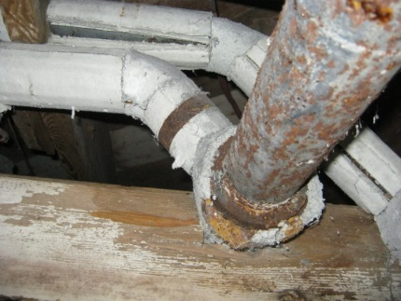
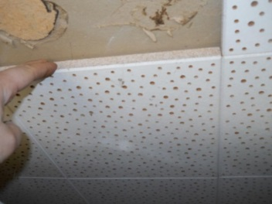
Objectives of DSS
Identify/quantify the extent of designated substances within building
Results dictate appropriate steps to control exposure to workers in building
Illustrate clearly the type and exact location of the materials containing a designated substance

Slide 26
Environmental site assessments
Phase I ESA
Phase II ESA
Site Remediation
Risk Assessment
Record of Site Condition
Notes:
Phase I
Non intrusive study to identify potential areas of concern
Phase I study completed prior to closing, usually at the request of the lending institution
Provides environmental record of the site
Phase II
Intrusive investigation to delineate the nature and extent of any contamination or hazardous materials present
Record of Site Condition
not required, optional clearance from MOE, requires additional work

Slide 27
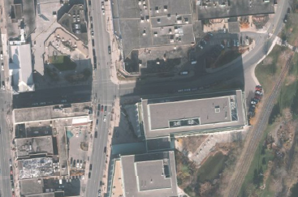
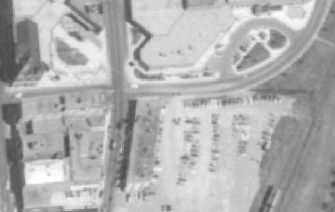
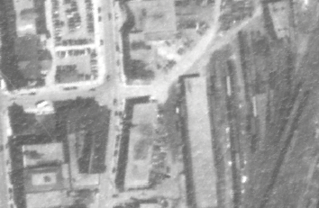
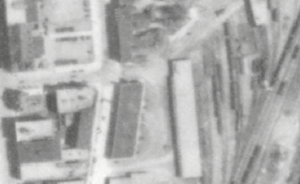
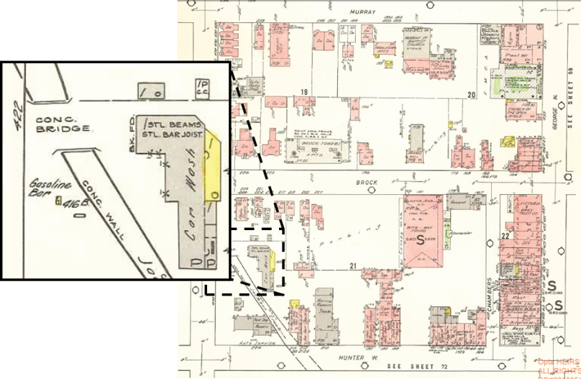
Environmental site assessments
Phase 1
Potential for…
Non-Intrusive Process
Components
Data Collection
Site Inspection
Interviews
Reporting
Notes:
-The objective is to define potential environmental liability associated with site and surrounding properties
-Non-intrusive study, desktop review
-Provides environmental record of the site and surrounding land
-Typically valid for 18 months

Slide 28
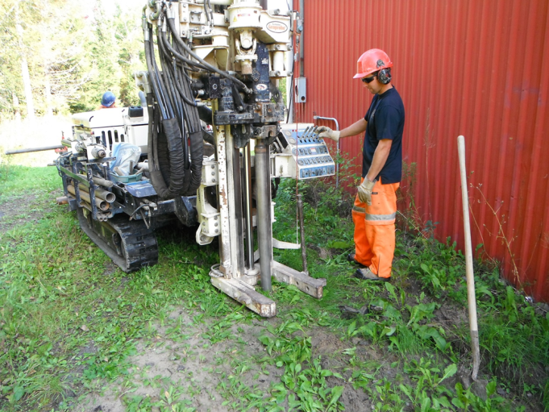
Environmental site assessments
Phase II
Nature & Extent
Intrusive Process
Components
Setup
Sample Collection
Analysis
Reporting
Notes:
OBJECTIVE
Determining nature and extent of contamination or hazardous materials, if present
The Phase II ESA scope is typically based on the results of the Phase I ESA
SETUP and SAMPLE COLLECTION
Completed through an intrusive study to collect subsurface soil/groundwater samples
Soil and groundwater are assessed
Comment on the size of rigs, capable of getting in tight places
Direction of GW flow is determined, helps to determine potential off-site sources or receptors of contamination
ANALYSIS
Analysis conducted by an accredited laboratory for contaminants of concern based on the Phase I

Slide 29
Remediation & Restoration
Ex-situ
Dig and Dump
Fastest remedial method
Sometimes not viable
In-situ
Least disruption
Collection and treatment
Biological/chemical remediation
Notes:
EX-SITU
-Excavate the contaminated soil, dispose of it at a landfill, replace soil with clean fill
-Depending on depth of contaminants, bedrock, and buildings, may not be a viable option
IN-SITU
-requires some equipment stored on-site, but can go ahead normal business operations with no interruption
-biological or chemical substrates are introduced into the groundwater where they will treat the contamination in the ground

Slide 30
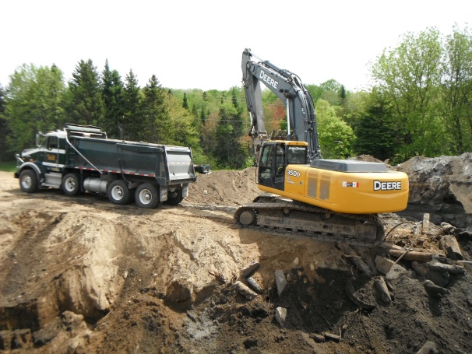
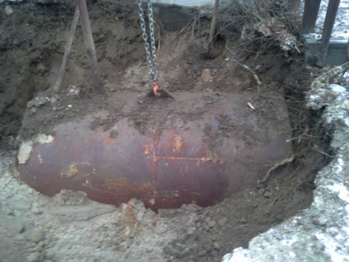
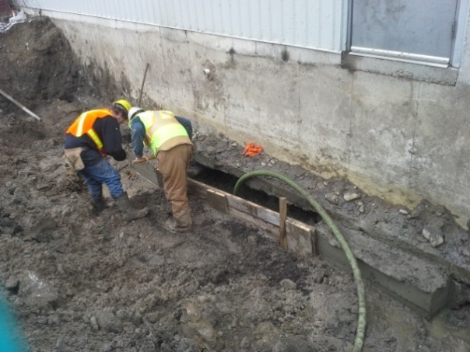
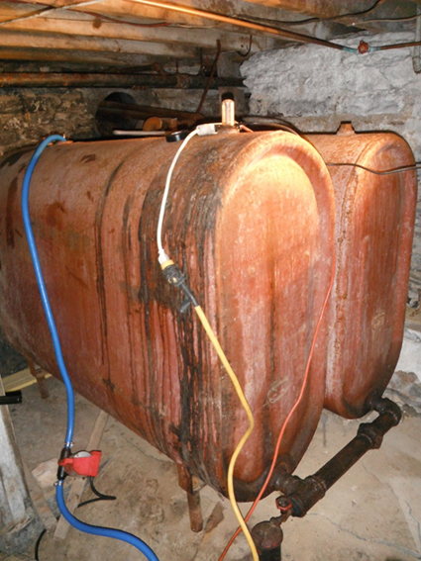
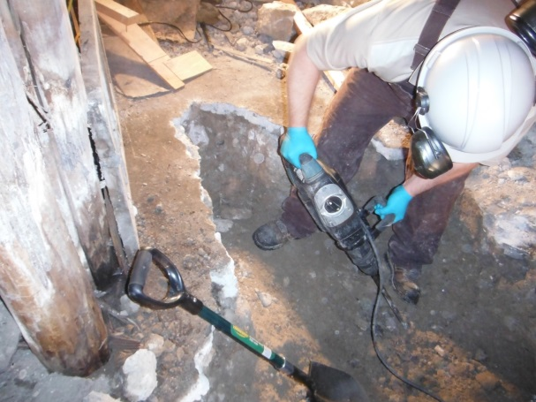
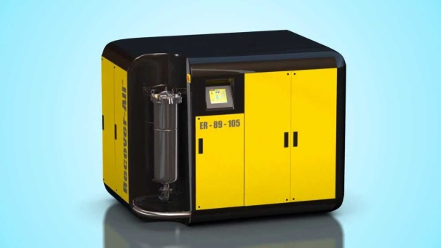
Remediation & Restoration

Slide 31
Weighing the Possibilities
Results of preliminary studies may constrain land use options
Remediation of property may add more options but remedial plan could be cost prohibitive
Site specific risk assessment may be used to establish unique environmental quality criteria

Slide 32
Risk Assessment
Changes generic MOECC criteria to be site specific
Takes site details and land use into evaluation
Generally increases allowable limit of contaminants
Remediation can be avoided
Expensive, but can save money overall
Typically used on large, deep or complex contamination

Slide 33
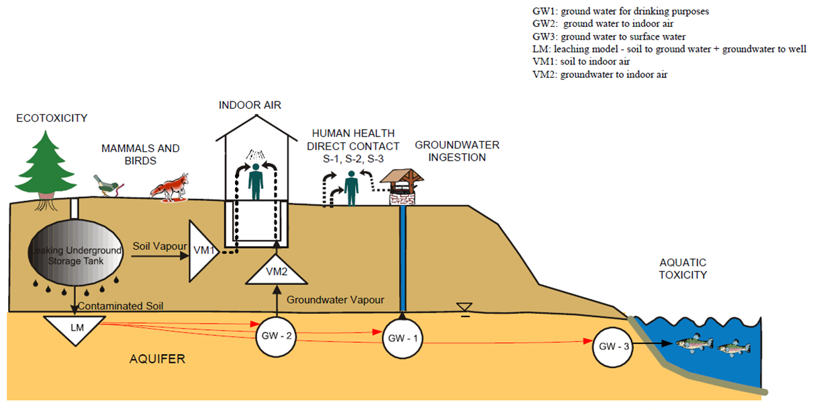
Risk Assessment & Management
Evaluation of site-specific criteria
Notes:
Comment that most downtown sites are paved, are not public areas or parks, and surface water is typically a safe distance away

Slide 34
Record of Site Condition (RSC)
Filed with the results of ESA(s)
Confirms contaminants are within thresholds or no evidence of contaminants
Regulated by the MOECC in Ontario - only true ‘Clearance’ provided
Time-stamps the criteria to the site, so that future criteria reductions do not trigger a new ESA requirement
Notes:
A record of site condition is a requirement of the Brownfields Tax Assistance program, but is NOT a requirement of the Municipal Brownfields Rehabilitation Grant Program

Slide 35
Record of Site Condition
Added assessment requirements
Conceptual Site Model
Site cross-sections
Site-wide contaminant analysis for soil and GW
6 to 24 months MOE review period
Does not address off-site impacts

Slide 36
Get Proactive on Brownfields
Often brownfields need a ‘nudge’
About the journey more than the destination
Ownership isn’t a must for progress
Community involvement has value
Ideally catalyst for cascade effect

Slide 37
Discussion…
Offer a comment?
Share your experience?

